Slide 1
System Administration
Cluster Selection Load
WMS Guide

Slide 2
Cluster Selection Load
The Cluster Selection Load resource is used to add, modify, copy, delete, and query the planning information for cluster picking in a given area.
Cluster selection is the term used to define the process of picking multiple outbound orders simultaneously within a single trip. The aim of cluster picking is to maximize the productivity of the picking personnel by minimizing travel time for each order.
There are two types of cluster picking within the WMS: user-directed (i.e. pick by label) and system-directed. For more details regarding cluster picking, refer to the “WMS Tecsys_Picking” document.
The cluster selection table is used for system-directed cluster picking only and defines the system-directed criteria.

Slide 3
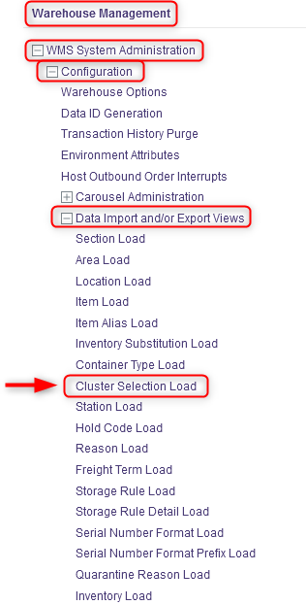
Cluster Selection Load
With a desktop computer, use the Warehouse Management menu.
Select the WMS System Administration resource.
Under WMS System Administration, click on Configuration.
Under Configuration, click on Data Import and/or Export Views.
Under Data Import and/or Export Views, click on Cluster Selection Load.

Slide 4
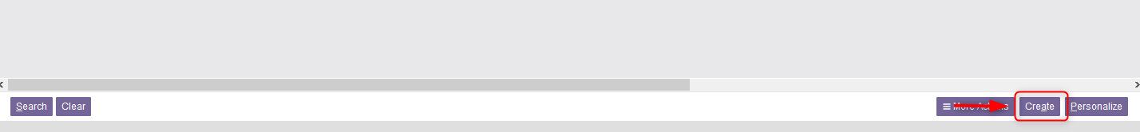
Cluster Selection Load
In the new window, the existing parameters for cluster selection already configured in the WMS will be listed.
If you want to create new parameters for a cluster selection, do this:
7.1 Click on Create at the bottom right of your screen.

Slide 5
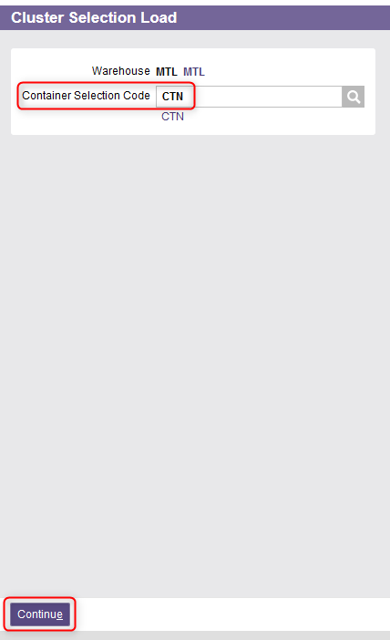
Cluster Selection Load
7.2 From the new window, enter the Container Selection Code.
This is the code that identifies the container's cluster configuration.
Use the lookup button to retrieve a container code if needed.
7.3 Click Continue.

Slide 6
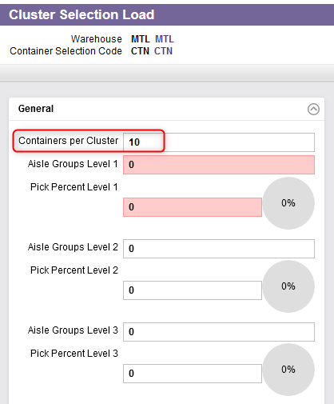
Cluster Selection Load
7.4 A new window will appear. In the General section, enter a value in the Containers per Cluster field.
This is the maximum number of containers for each cluster.

Slide 7
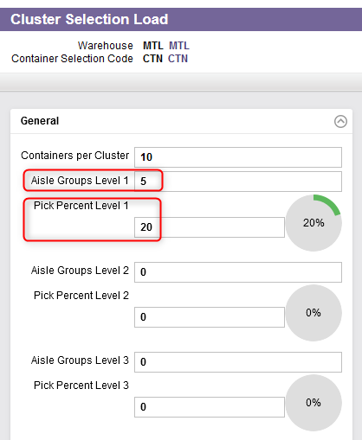
Cluster Selection Load
7.5 Enter a value for the following two fields:
Aisle Groups Level 1: This is the number of aisle groups to be considered for consolidation in a cluster for the indicated level. Aisle groups are used to identify the locations that are found in a group. A value greater than zero must be entered in this field.
Pick Percent Level 1: This is the minimum percentage of picks for the indicated level. A value greater than zero must be entered in this field.

Slide 8
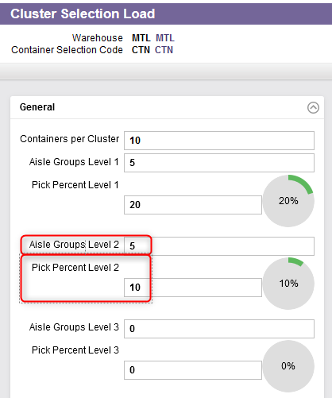
Cluster Selection Load
7.6 Enter a value for the following two fields:
Aisle Groups Level 2*: This the number of aisle groups to be considered for consolidation in a cluster for the indicated level. If a value greater than zero was entered in the Pick Percent Level 2 field, then the value specified here must be greater than zero.
Pick Percent Level 2*: This is the minimum percentage of picks for the indicated level. If a value greater than zero was entered in the Aisle Groups Level 2 field, then the value specified here must be greater than zero.
*You must ensure that there are no gaps between this level and the previous level, otherwise, your entry is rejected.

Slide 9
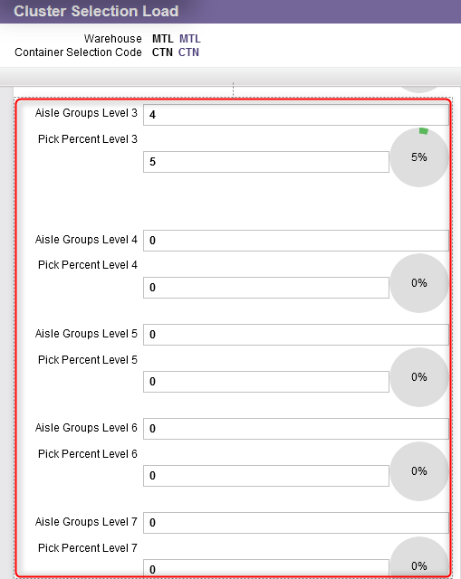
Cluster Selection Load
7.7 Repeat the same step 7.6 for all other levels 3 to 10 if necessary.

Slide 10
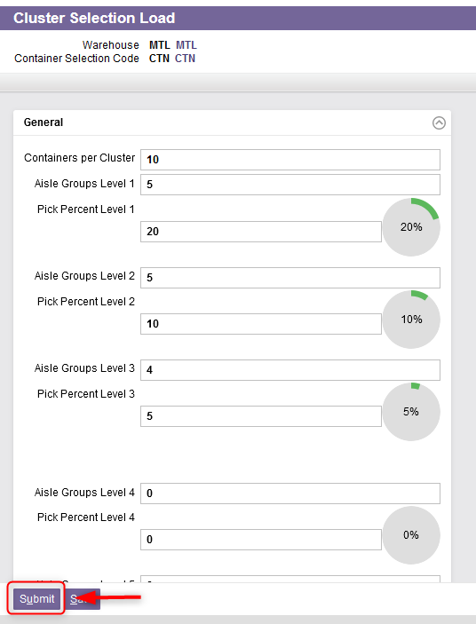
Cluster Selection Load
7.8 Once all the fields properly entered, click on Submit.
The parameters for the cluster selection have been created.

Slide 11
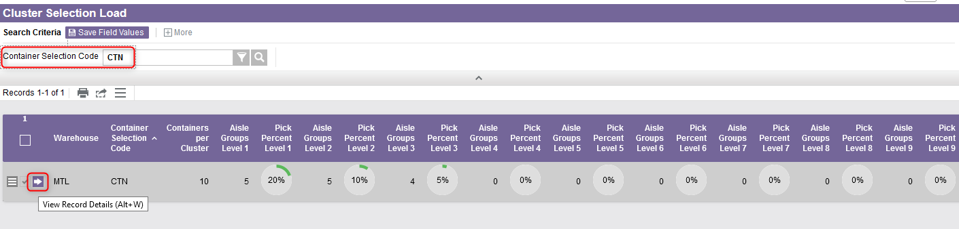
Cluster Selection Load
If you want to update parameters for a cluster selection, do this:
  8.1 Perform a search to retrieve the cluster selection you wish to update and click on View Record Details.

Slide 12
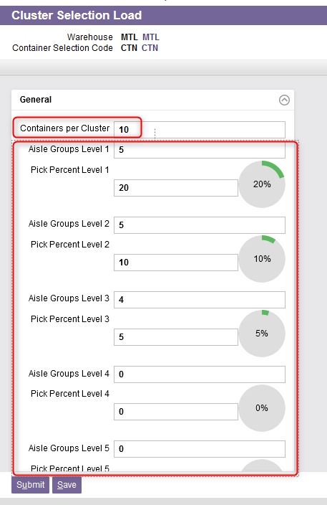
Cluster Selection Load
8.2 From the new window, in the General section, update the following fields as required:
Containers per Cluster, that is the maximum number of containers for the cluster.
Aisle Groups Level 1 to 10 and Pick Percent Level 1 to 10: Refer to the slides 7 to 9 for details.

Slide 13
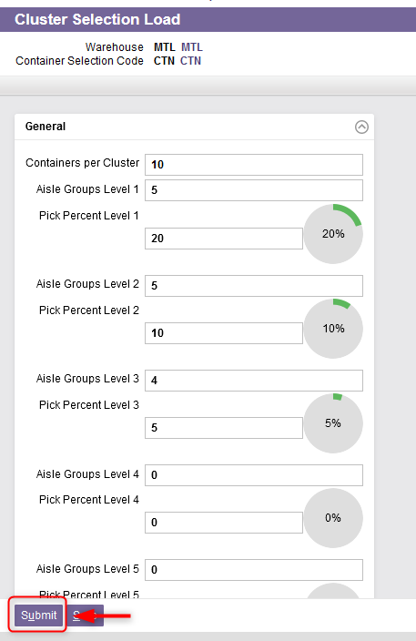
Cluster Selection Load
8.3 Once all the fields properly updated, click on Submit.
The parameters for the cluster selection have been updated.

